Slide 1
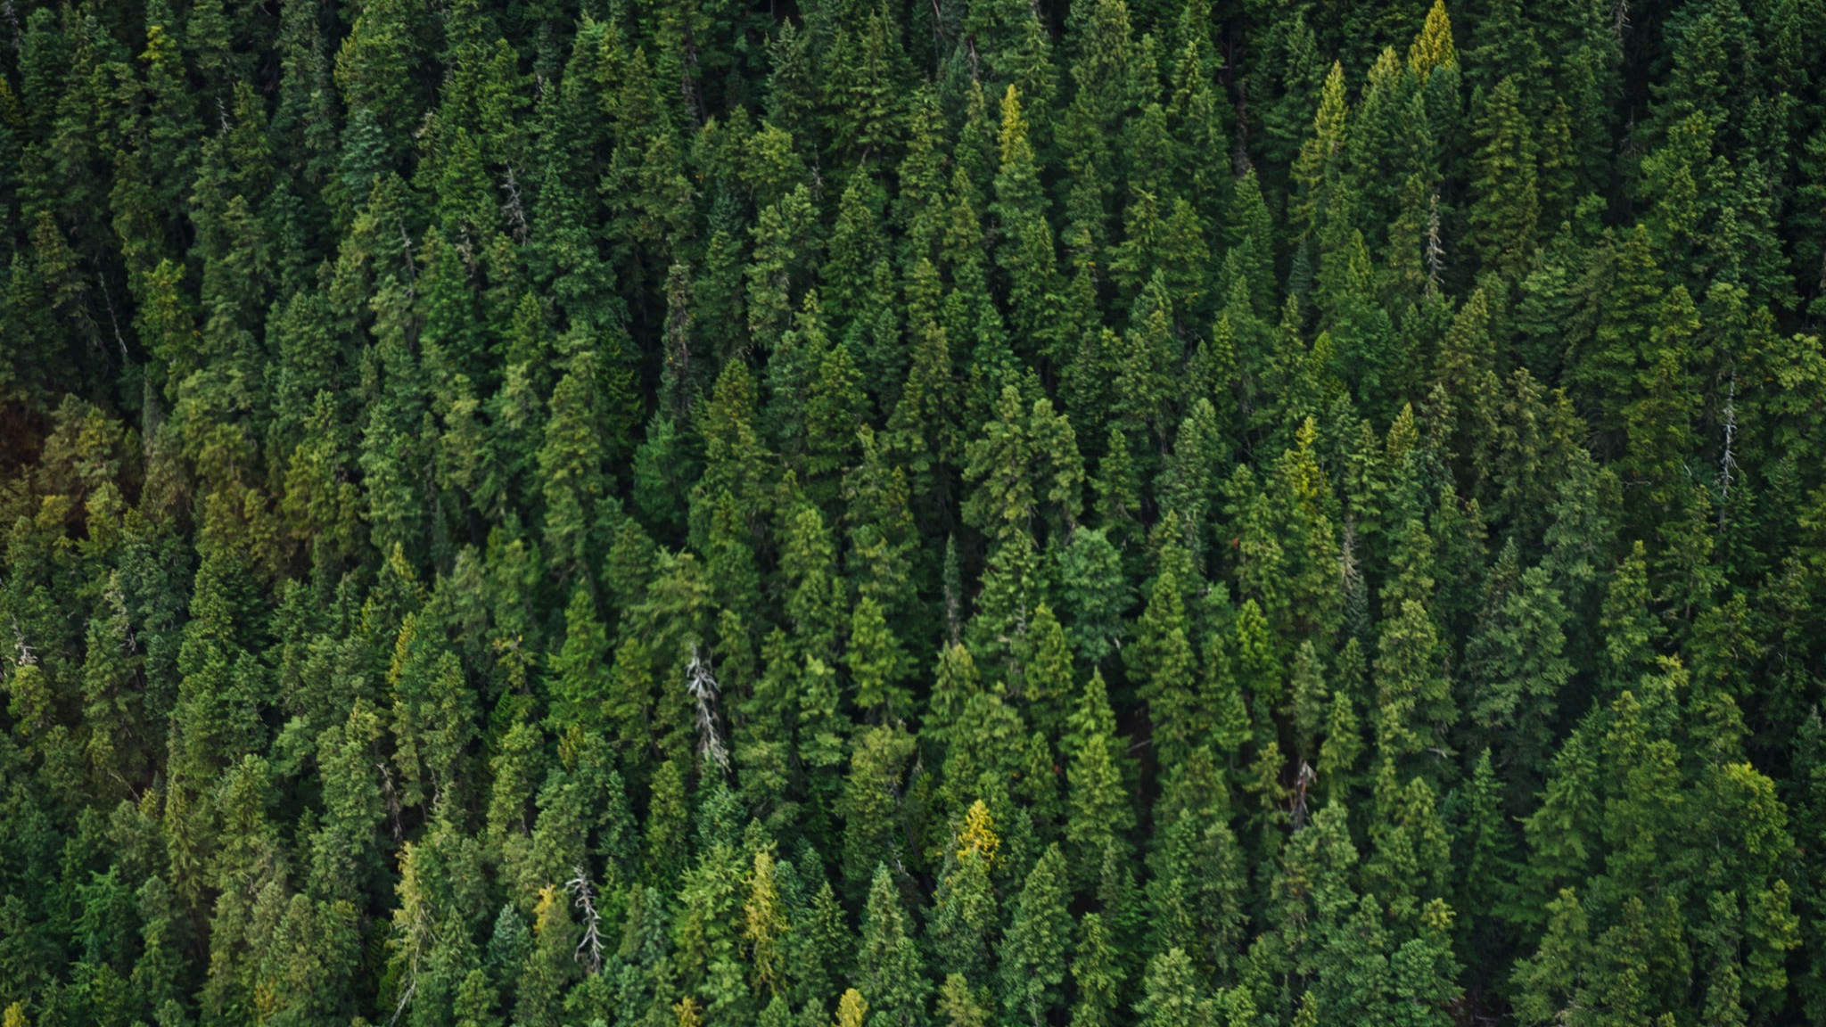
Kheti Insight
By: - Dev Lapsiwala, Vedant Agarwal, Vedant Agrawal, Pranay Singhal

Slide 2
The purpose
Low yields
Unsustainable farming
Unaware of the latest technology
Section
Section
12
The project is designed to provide farmers of India, who are not being given an equal opportunity, a change to connect to technology and make their practices sustainable.
⬤ Opportunity 1
Farmers don’t have the knowledge or the capability to increase their yields
⬤ Opportunity 2
They are not being able to get enough income to try and attain a higher yield.
⬤ Opportunity 1
The farmers don't have the knowledge of how to use water and fertilizers in a sustainable manner
⬤ Opportunity 2
The soil quality of the farms keeps decreasing over time
⬤ Opportunity 1
Farmers cannot afford technology to make their lives easier due to cost.
⬤ Opportunity 2
The farmers don't know what all is available in the market today.

Slide 3

The Vision
Section
We aim to make the lives of indian farmer more economical, ensure their practices are sustainable and ensure that they are well connected to technology. This can be accomplished by teaching them about their soil health and helping them understand how to change their practices to more sustainable methods in order to be more eco friendly all while increasing their yields.

Slide 4
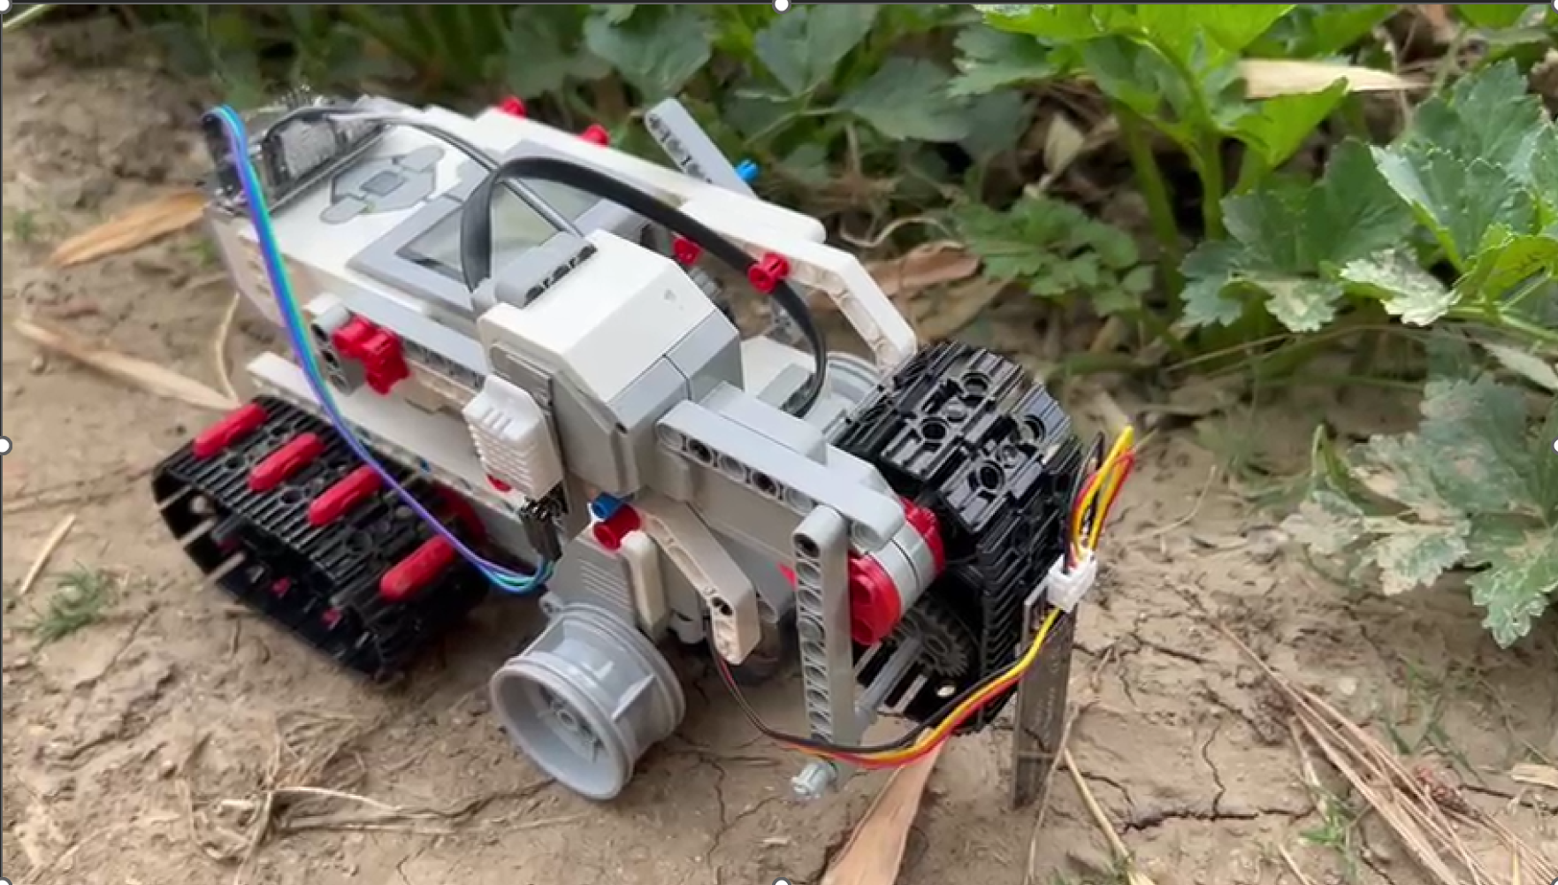
The Initial Prototype

Slide 5
Challenges faced while developing the working model
Section
Section
12
Coding
Coding was one of our biggest challenges. Our robot had to move in all directions, control a servo actuator to raise and lower a sensor, and take input from another sensor—all at once. Managing this complexity led to messy code that didn’t work properly. We needed help from multiple mentors to fix and organize it, which taught us the importance of clean code and planning.
Wiring
Wiring was a major challenge since we had little experience and many components to connect. Tools like Fritzing and Tinkercad didn’t have the parts we needed, which made planning difficult. Eventually, we found Cirkit Designer, which worked well, and with help from a mentor, we were able to wire everything correctly.
Power Supply
Power supply was another key challenge. We initially used 9V batteries, but our motor driver and tank drive drained them quickly—we went through at least four. It became clear that the setup needed more power than the batteries could provide. We switched to a wall connection for reliable performance, but we still haven’t found a practical onboard solution for powering the bot.

Slide 6
Video Demo

Slide 7
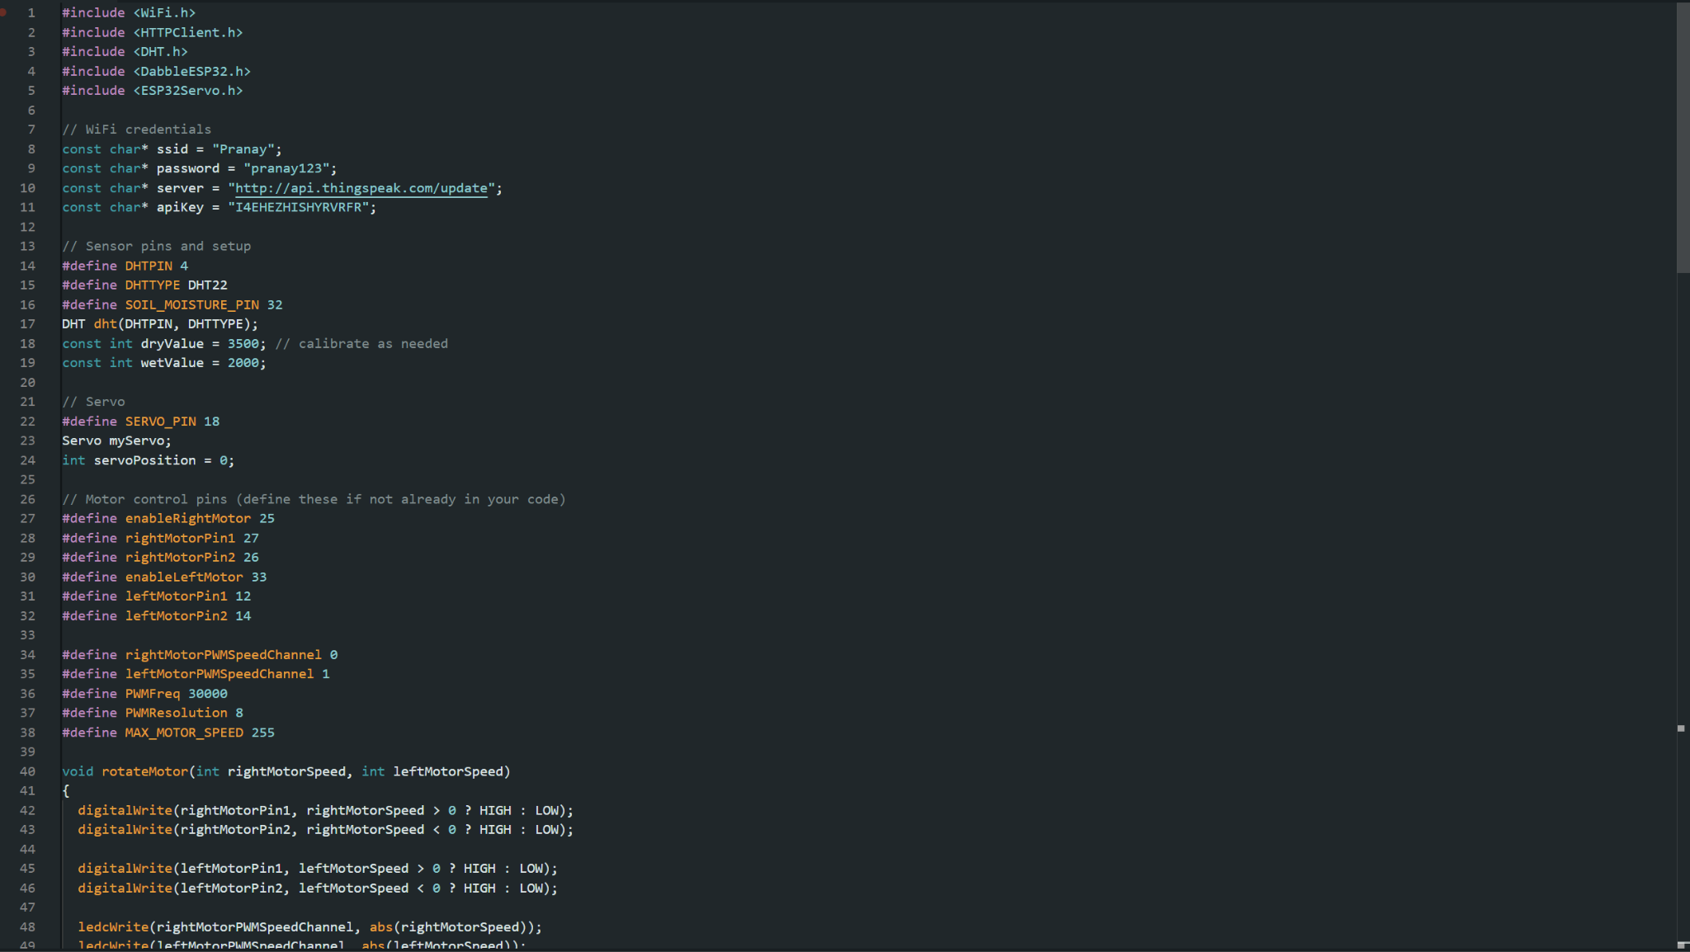
The Code

Slide 8
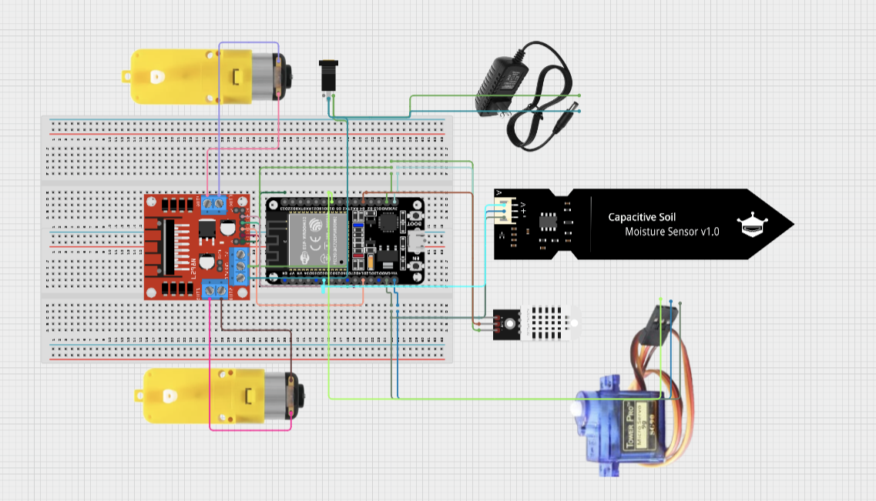
The Wiring

Slide 9
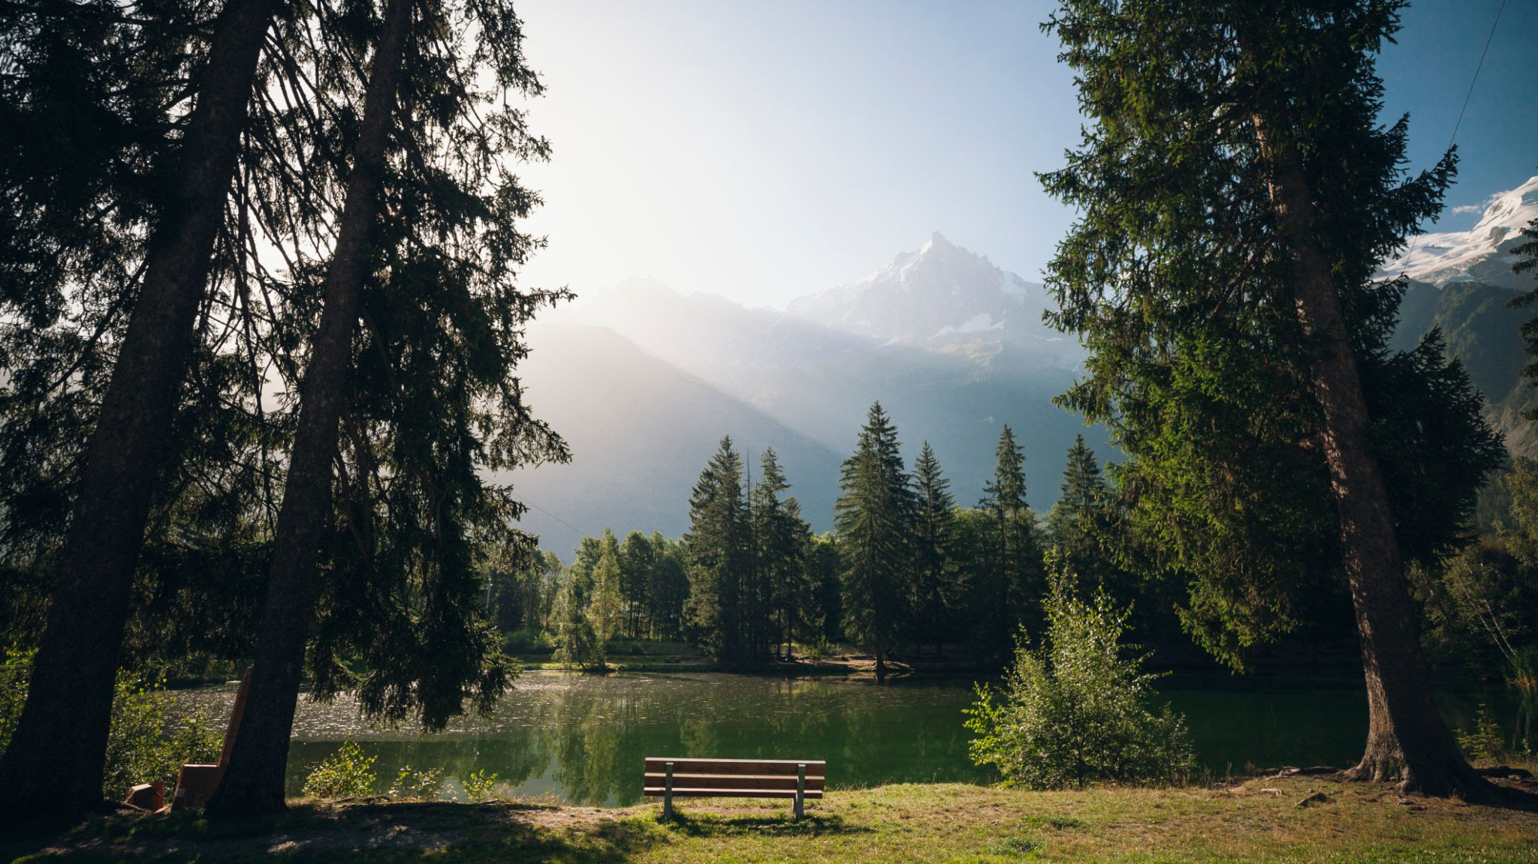
Thank You
Team 6

Slide 10
Questions
Section
What problems have you faced in trying to work with farmers
What are problems you are looking to solve?
How have you interacted with farmers of lower income levels?
What were the farmers outlooks on your product?
How does your product place in the necessity of the farmers?

